Slide 1
JUKEBOX PROJECT
Guided by Vaibhav Diwan & Charul Bapna

Slide 2
What is Jukebox?
a machine that automatically plays a selected musical recording when a coin is inserted.
Jukebox is a music player.

Slide 3
Features of the Jukebox Project:-
Displaying all the songs.
Play/pause the song
Creating playlist
Add song to the play list.

Slide 4
Classes & Attributes
We selected few thing as the classes & it’s attributes:-
Class Atrributes
Artist artist name
Gener gener type
Play List playlist ID, Playlist Name
Songs SongId, SongName, Duration, SongPath
PlaylistSong playlistId, SongId

Slide 5
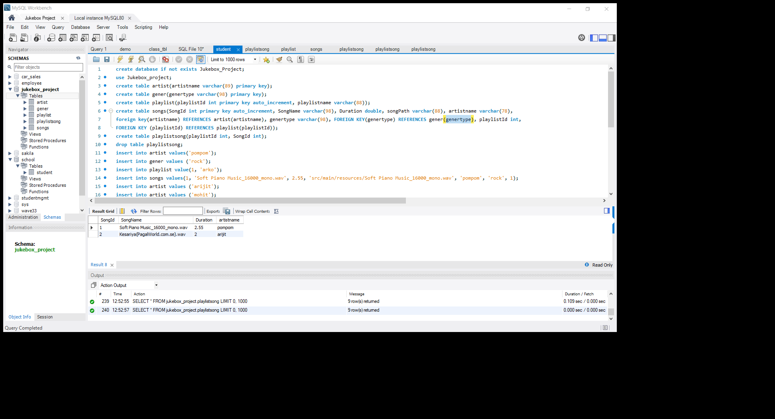
Creating the database:-
At first we’ve to create the database structure to begin the project. The following database structure have been followed in my project:-

Slide 6
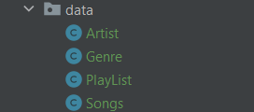
Creating Basic Classes:-
As basic class for storing the data we’ve created below classes:-
Here we’re storing data & declaring the attributes.

Slide 7
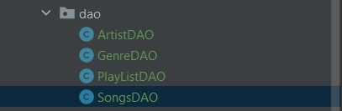
Data Access Objects:-
It is a simple java class which contains JDBC logic . Data Access Layer has proven good in separate business logic layer and persistent layer. The DAO design pattern completely hides the data access implementation from its clients.
Here we are declaring 4 Dao classes:-

Slide 8
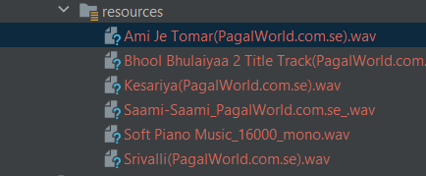
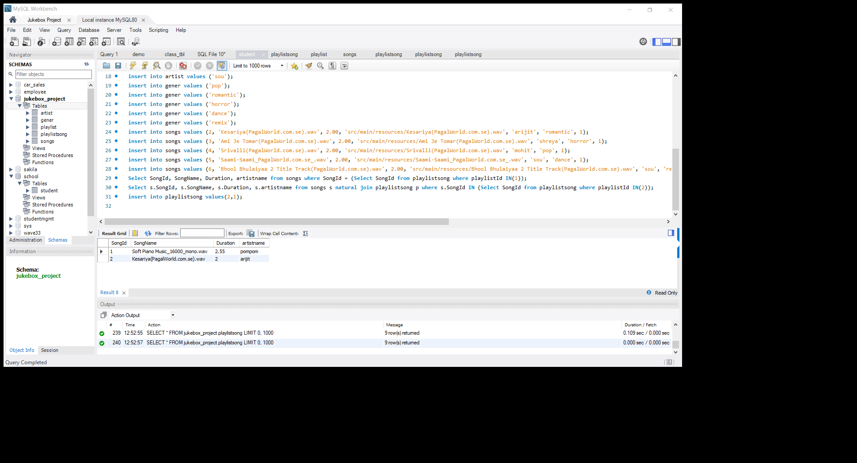
Storing the Songs:-
We’ve store the songs in our resource folder, which content root path has been used to store it in database also.

Slide 9
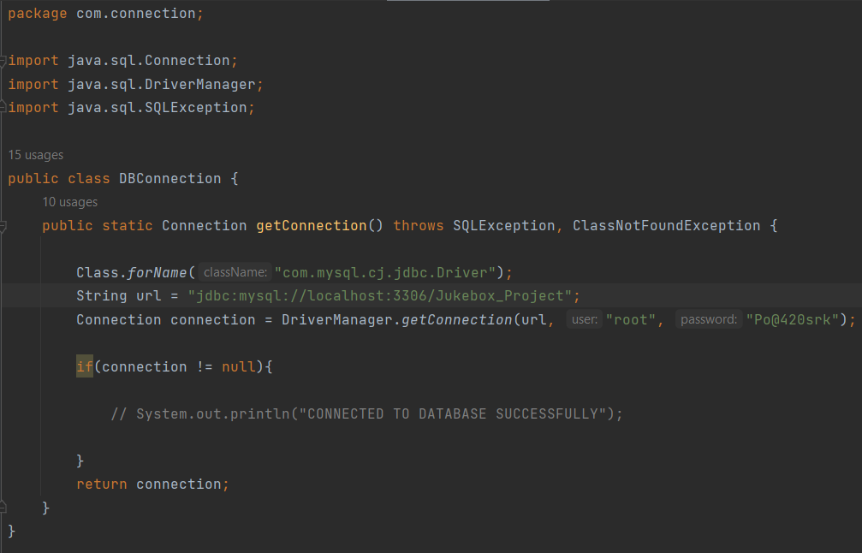

Creating Connection:-
For running the programme the important part in connecting with the database. For doing it we create a separate Dbconnection Class.
And using the code we’re creating connection with our database.

Slide 10

Operations:-
To running the jukebox we need few methods & operations that are stored in the separate classes named, JukeOperation for the jukebox & audioplayer for the song & it’s all activities.

Slide 11

Main method:-
After completing the all the following task, we’ve to create our main method so that it can work properly.
In Implementation Class we’ve stored all our main methods, so the task properly run & jukebox working properly.

Slide 12
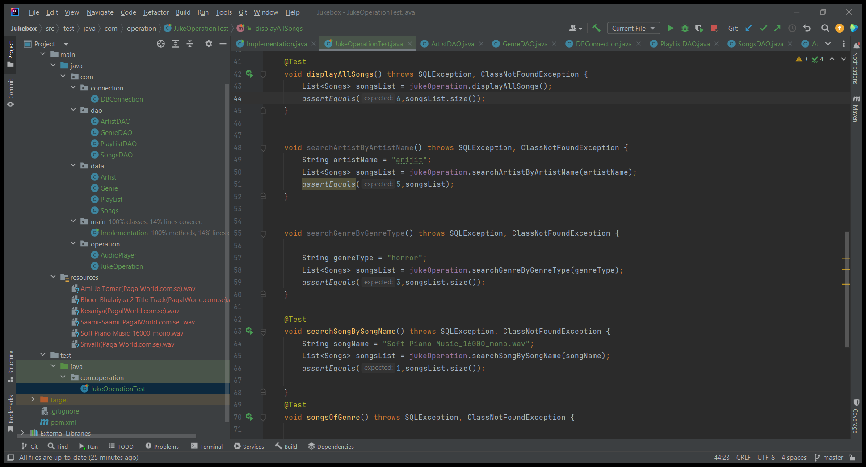
Test Case:-
Creating test cases are important for the project so that we can identify if the project running properly or not.
Here are the few test cases we’ve created for the project.

Slide 13
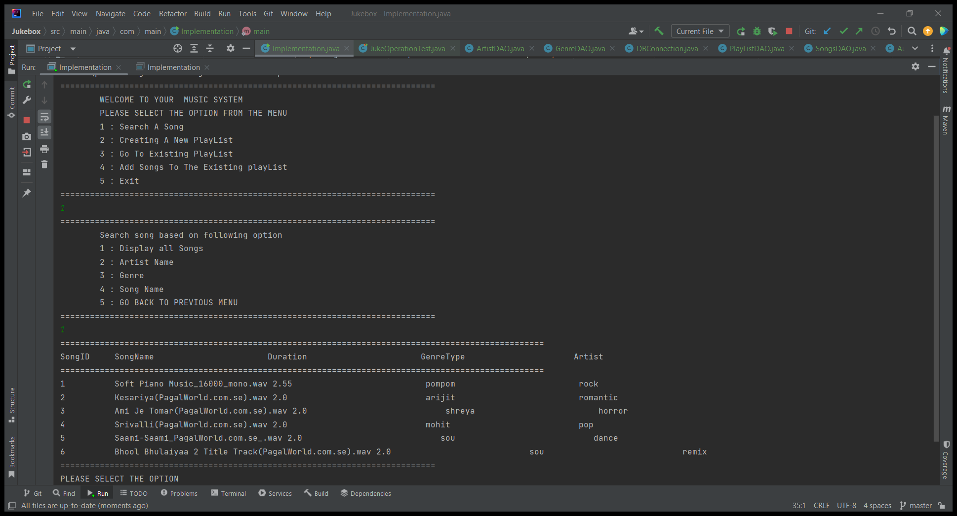
Output:-

Slide 14


